Slide 1
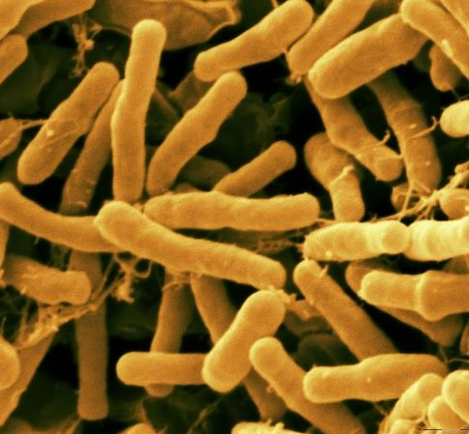
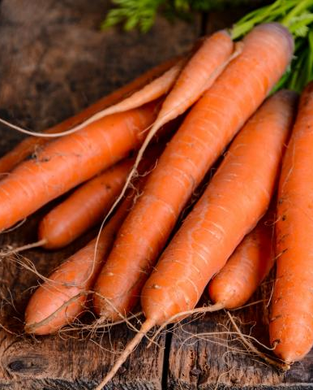
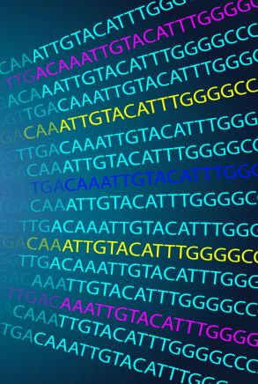
OpenRefine and R to Assist in Stable Transformation Process
BIOL 792 Biological Datasets Project
Dr Julie Allen
Presenter: Pankaj Bhatta

Slide 2
OVERVIEW
I. Introduction
II. Carrot Stable Transformation
III. Problem
IV. Goal of the project
V. Data & flow of operation
VI. Conclusion
VII. Future direction

Slide 3

Introduction
Pankaj Bhatta
-Graduate student in CABNR
-Research in Dr Santos Lab
-Plant chemical defense mechanism
Study the roles of polyacetylenes in plant defense against fungal pathogen
Project involves carrot stable transformation
Notes:
Plant defense mechanism- only work on one of the defense mechanism which is chemical defense mechanism.

Slide 4
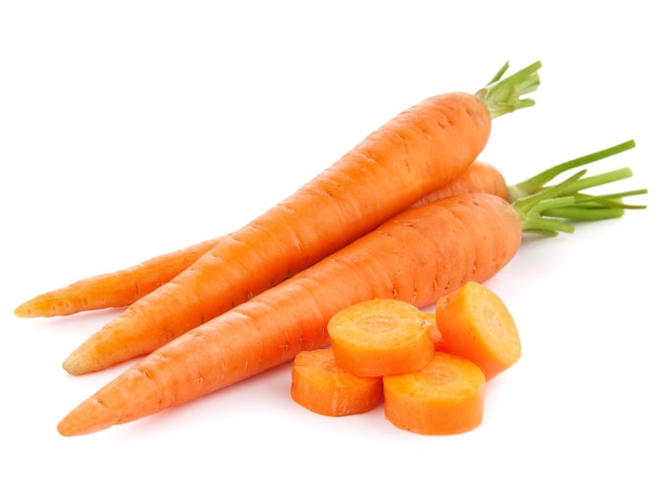
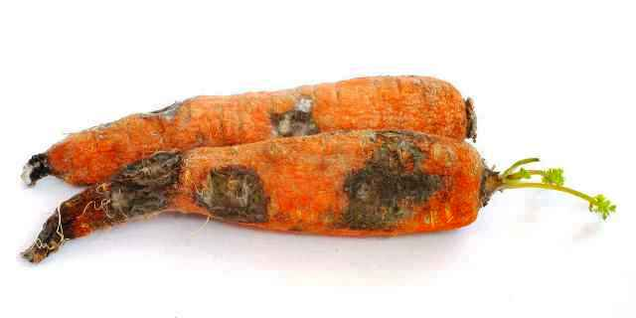
Background
Carrots
-Annual crop value: ~$864 million (US)
- 4th largest producer of carrot (US); ~1.4 million tons/year
7th most consumed vegetable crop in the US
Rich in nutrition
Rich in useful plant compounds
NDTV food
Problem
- $375 million loss/year due to plant pathogen- Sclerotinia sclerotiorum
- One of the most common pathogen- causes white rot
- Infects more than 600 plant species
Krishi Jagran
Notes:
Nutrition: carbs, fibers, vitamins (A, K1, B6), and minerals
Compounds: beta-carotene, alpha-carotene, anthocyanins, and polyacetylenes (the compound of our interest)
There are chemical fungicides that can control these fungus temporarily but these fungus will likely develop resistance against them. Fortunately, carrot have their own chemical defense mechanism to fight pathogen like Sclerotinia sclerotiorum.

Slide 5
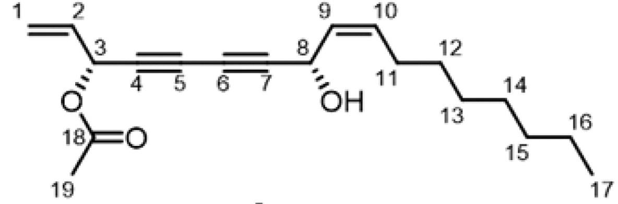
Polyacetylenes
-Polyacetylenes are naturally occurring aliphatic with one or more than one triple bond (17-18 C length)
Importance
Found in skin or periderm
Anti-cancerous, antifungal, antimicrobial properties along with other nutraceuticals properties
Notes:
A nutraceutical or 'bioceutical' is a pharmaceutical alternative which claims physiological benefits.

Slide 6
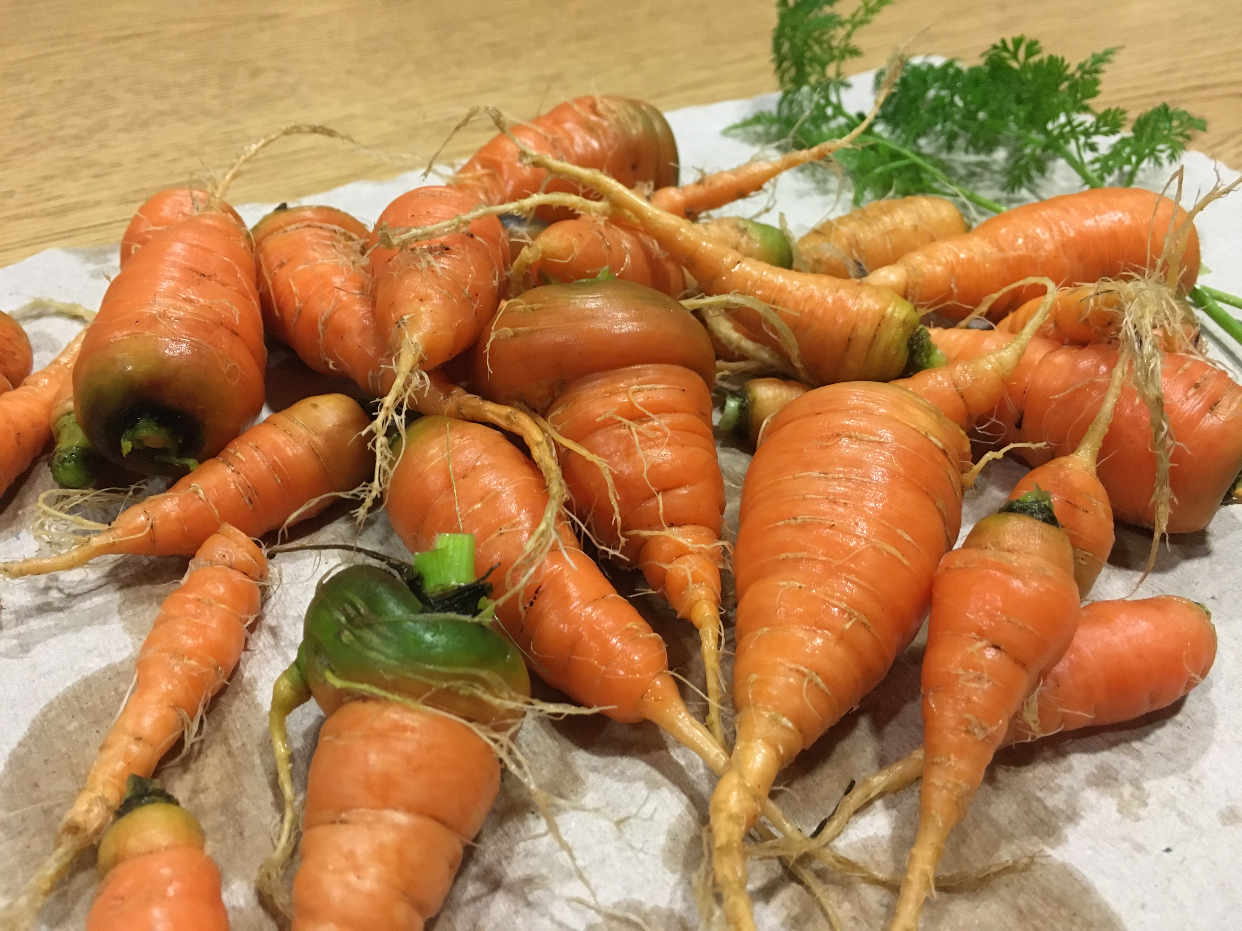
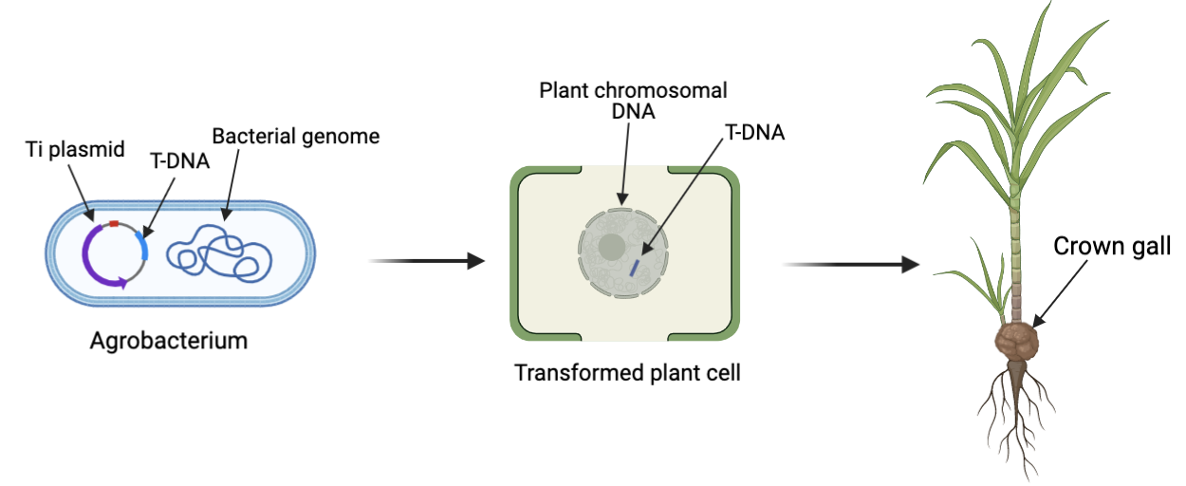
Carrot stable transformation
Danvers Half Long (DHL)
What is stable transformation?
Permanent introduction of gene into a plant i.e., gene will be integrated into the host genome
Agrobacterium transformation
Credit: PB
Agrobacterium tumefaciens
Credit: Dylan Kosma
Created in Biorender
Notes:
Must say: stable transformation of carrot is a very long process that takes up to 8-9 months.
Gene after stable transformation is expressed continuously and will also be expressed in later generations of the plant.
I am using two different varieties of carrots: Darcus carota and Scarlet Nantes
the acetylase (FAD-2 like) gene ACET_552
using the falcarin biosynthetic enzyme to
Agrobacterium transformation
Well established
Natural ability to transfer gene
Although this is not a novel technology, I am working on this to establish this protocol in our lab to study the function of genes we want to study
Agrobacterium transformation in carrots takes about 8-9 months total
Onco genes that give rise to tumors have been removed.
Onco gene have been removed with our goi.
Disarmed plasmid

Slide 7
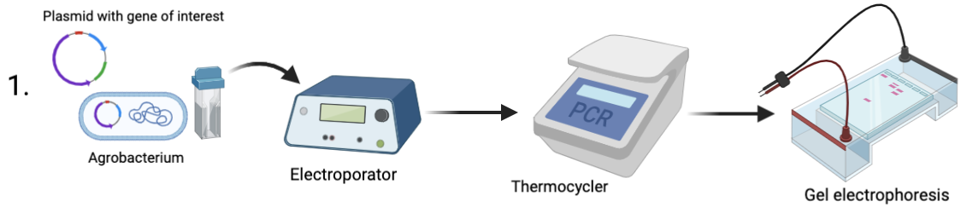
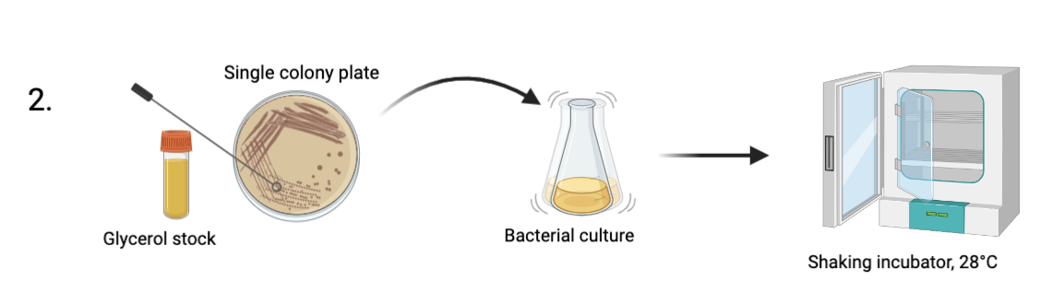
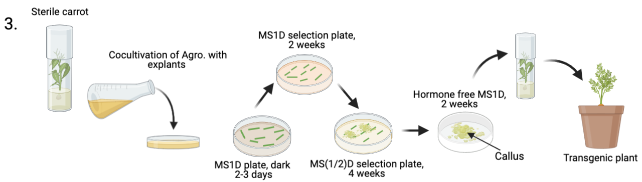
Method
-Agrobacterium strain was transformed with our gene of interest-
Acet_552
controls –1)EV (empty vector) 2)PEAQ_p19_GFP
-Culture was used to transform our carrot’s explants
Created in Biorender
Notes:
Explants are basically portion of shoots, leaves, stems, flowers, roots etc.
Petiole: the stalk that joins a leaf to a stem
1) Diarmed agro strain- meaning it still transfer our GOI, but not induce crown gall
2) Add PCR machine

Slide 8
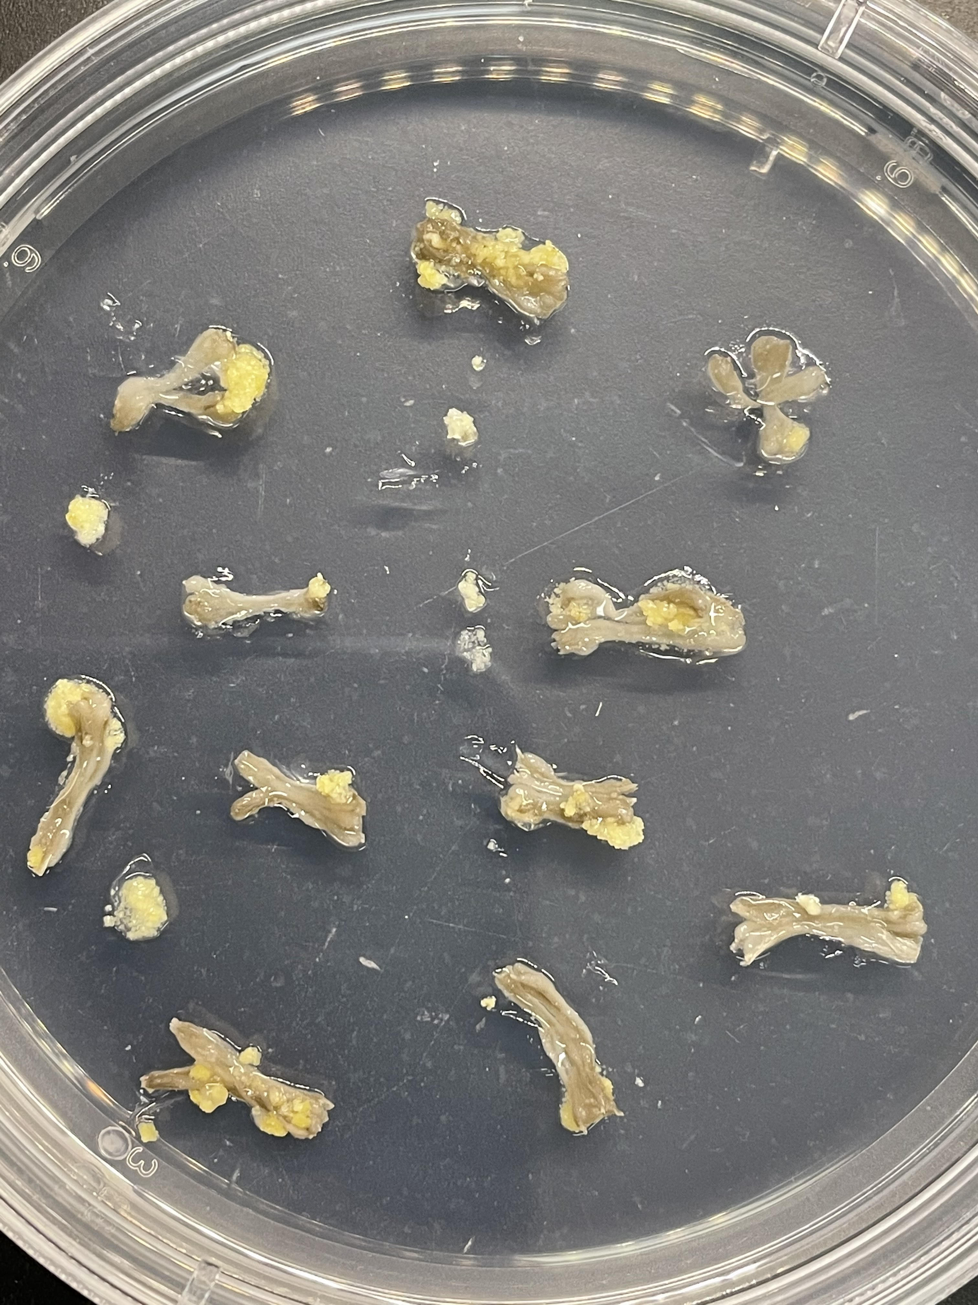
Callus Formation
Notes:
This is callus formation from our control- non transformed callus
We are waiting for our acetylenase and GFP to produce callus

Slide 9
Problems
Stable transformation is a very long procedure
Different parameters involved
Hard to navigate the best option
Notes:
Different parameters involved makes it difficult to predict efficiency

Slide 10

Goal of the project
To find the combinations of parameters involved that will give the highest percentage of polyacetylene content for our stable transformation

Slide 11
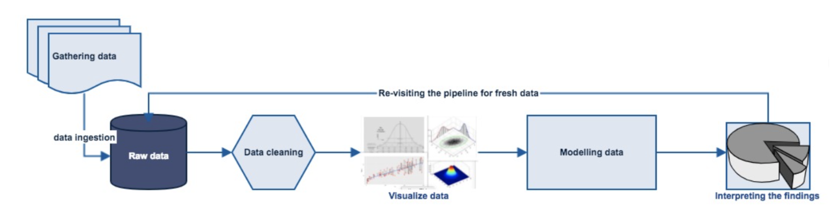
Flow of operation
OSEMN
Vinit Saini @ dzone.com
Data science pipeline is followed:
Obtaining data (O)
Scrubbing/Cleaning data (S)
Exploring/Visualizing data (E)
Modeling data (M)
Interpreting data (N)
Notes:
In simple words, a pipeline in data science is “a set of actions which changes the raw (and confusing) data from various sources (surveys, feedbacks, list of purchases, votes, etc.), to an understandable format so that we can store it and use it for analysis.”
Reference: https://dzone.com/articles/overview-of-the-data-science-pipeline

Slide 12




Data
- Project sheet including metadata and versions
- Version 2-1 in .csv format
(used OpenRefine )

Slide 13



Flow of operation
Cleaning data
Visualizing data
Modeling and interpreting data
Notes:
Linear model= 75% training, 25% prediction.

Slide 14
Conclusion
According to our Bar graphs and Plots figures, the best combination would be:
Carrot variety – DHL (Danvers Half Long)
Carrot part – Root
Agrobacterium type – LBA4404
Gene – acet_552

Slide 15
Future direction
- More data: different time points, more explants, different varieties, GC data
- Proper conversion of categorical data into nominal data
- Understanding and using better predictive models- neural network, logistic regression, KNN, random forest
- Understand and find the correlation, and use Occam's razor to eliminate unwanted parameters for polyacetylene % prediction
Notes:
Linear regression: predict our model
Correlation: what is the relationship between our x and y value
More data- different time points, more explants, different varieties
Proper conversion of categorical data into nominal data
Understanding and using better predictive model- neural network, logistic regression, KNN, random forest
Understand and find the correlation, and use Occam's razor to eliminate unwanted parameters for % prediction
Python has better and more options model prediction, so maybe using python for model prediction would be better

Slide 16

Thank you! ☺

